Slide 1

Fraud Detection Analysis
Presenter Bhavana Soni

Slide 2
Agenda
Project Overview
Data Description &
Data Cleaning
Data Visualization
Model Selection
Conclusion
& Interpretation
Presentation Title

Slide 3

Project Overview
Key Features:
Monetary value of each transaction.
Helps identify unusually high or low amounts.
Detects outliers indicative of potential fraud.
Improves model accuracy in distinguishing fraudulent transactions.
Enables faster response to potential fraud cases.

Slide 4


Sample Size: - 6,362,620 Features: - 11 Target Variable: - isFraud (0 & 1)
Data description

Slide 5
Data Cleaning
Missing Values
Duplicate
Data Type
Outlier
Imbalanced
No Missing Values
No Duplicates Values
Each feature has an appropriate data type to prevent analysis errors.
Outlier is present
Doesn’t remove them.
Higher outlier represents frauds/scam
Target Variable is highly imbalanced.

Slide 6


Slide 7
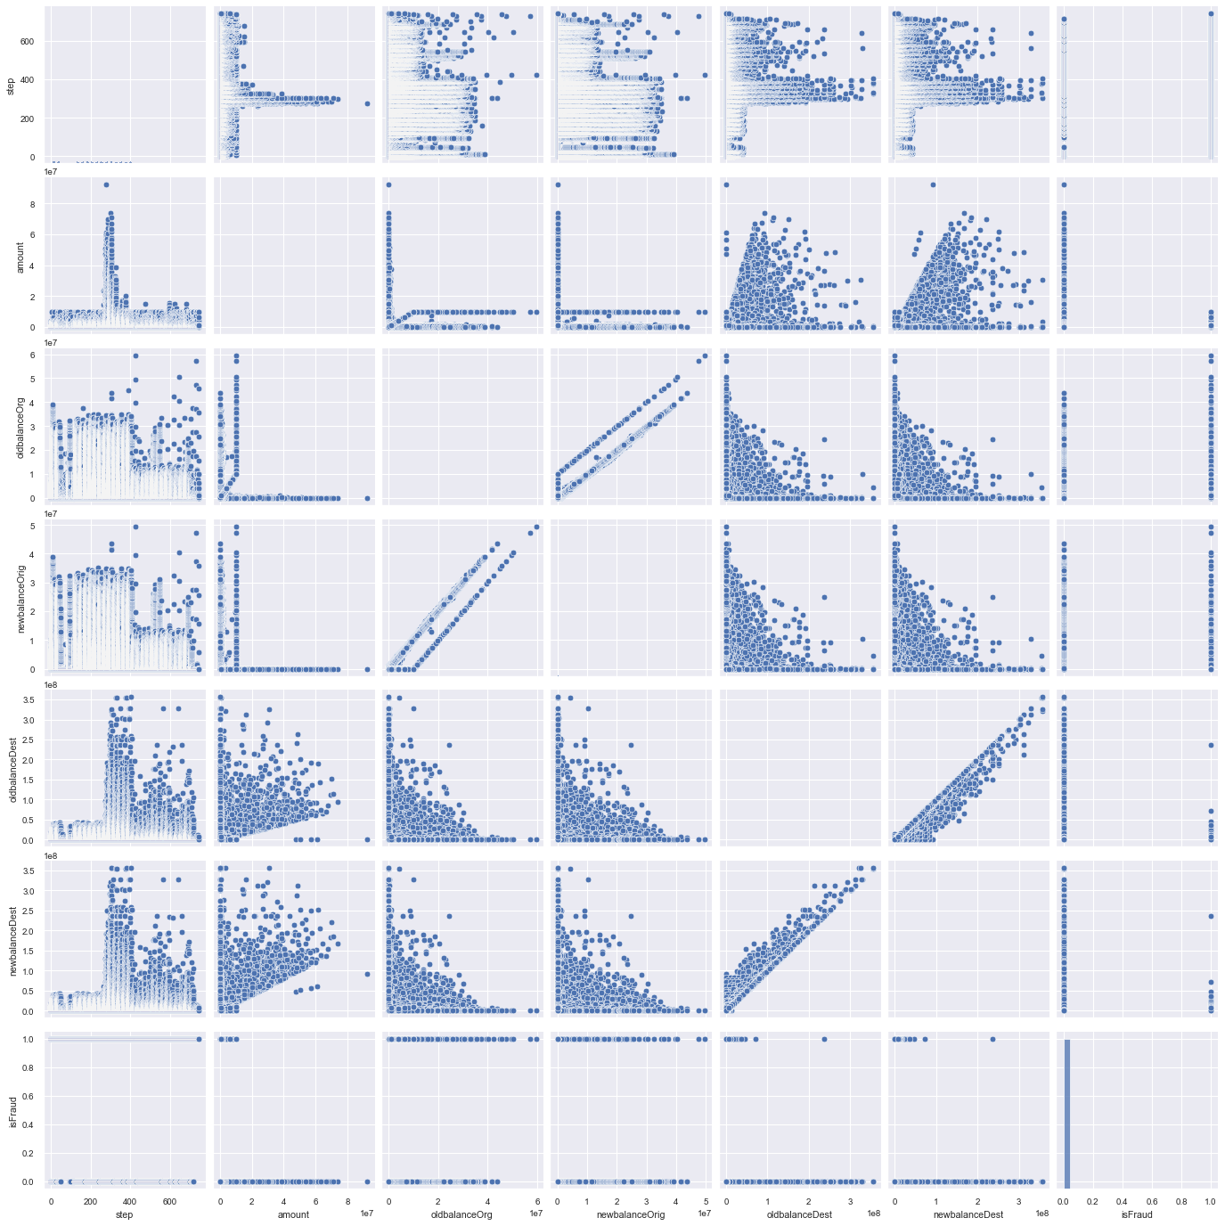
High Class Imbalance:
Few fraud cases vs. many non-fraud.
Skewed 'Amount’:
Mostly small transactions, few large.
Balance Shifts:
Unexpected changes in balances may indicate fraud.
Time Matters ('step’):
Fraud patterns might emerge over time.
Interacting Features:
Key to Fraud Prediction
Highly Correlated Features

Slide 8
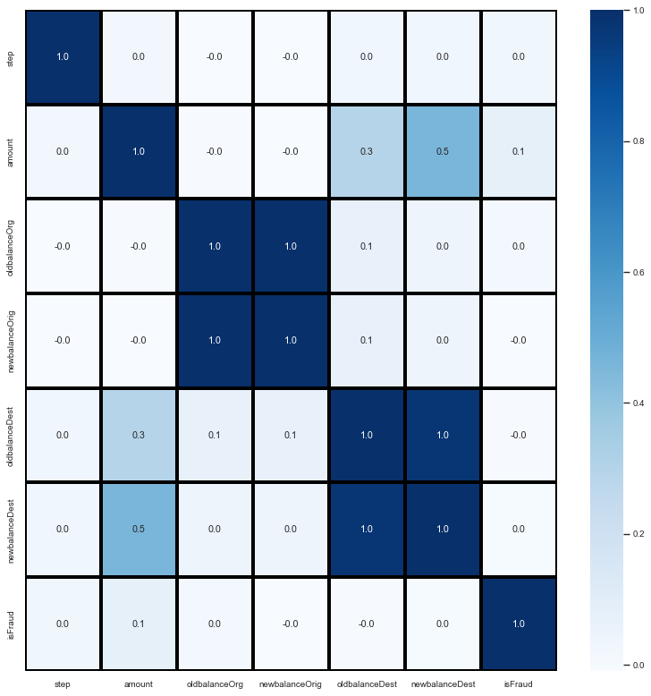
Amount & Destination Balances:
Moderate positive correlation observed.
Weak Direct Fraud Correlation
'Step’ :
Has no or less Relationship:

Slide 9
EDA
Target Variable
Data Visualization Of Imbalanced Data explained on next slide
X – Independent Variable (all features)
Y – Dependent Variable (Fraud)
Label Encoding
Done encoding of “type”
Assign numeric values
Train / Test Split
Imbalance
80% - Training
20% - Test
Handling Imbalance of Target Variable
Applying SMOTE Technique

Slide 10
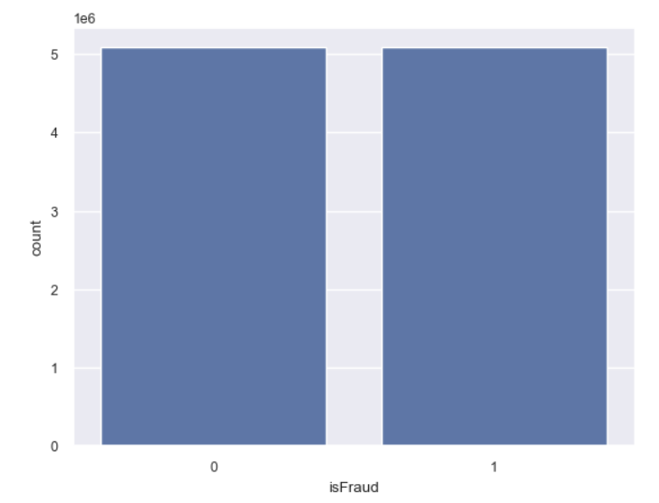
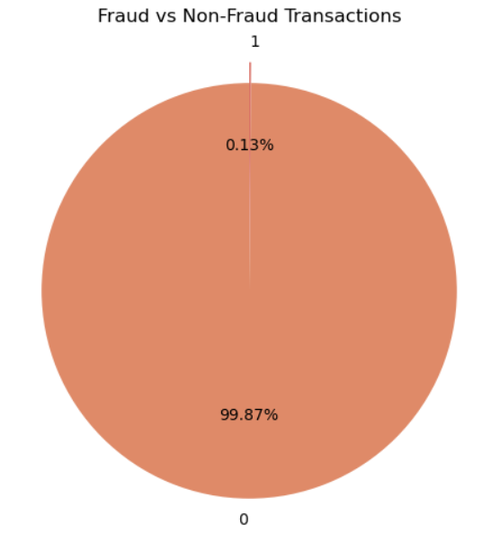
Data Imbalance
Target Variable is highly imbalanced
Non Fraud → 99.87%
Fraud → 0.13 %
Handling Data Imbalance
Apply SMOTE Technique on Training data.
Make Target Variables balanced

Slide 11
Model Selection
Logistic Regression
KNeighborsClassifier
Decision Tree Classifier
Random Forest Classifier
Gradient Boosting Classifier
XGBoost Classifier
Gaussian Naive Bayes
Multinomial Naive Bayes
Bernoulli Naive Bayes
Bagging Classifier
AdaBoost Classifier

Slide 12
Model Observation
Model | Accuracy | Precision | Recall | F1-Score | Key Observation
Logistic Regression | 0.912 | 0.013 | 0.892 | 0.025 | Tends to misclassify many normal transactions.
Decision Tree | 0.986 | 0.079 | 0.96 | 0.146 | Identifies most fraud but also misclassifies many normal activities.
Random Forest | 0.987 | 0.087 | 0.988 | 0.16 | Catches the highest amount of fraud but with a significant number of incorrect classifications.
Gradient Boosting | 0.998 | 0.272 | 0.362 | 0.311 | Better at correctly classifying normal transactions but misses considerable fraud.
AdaBoost | 0.999 | 0.94 | 0.478 | 0.634 | Most successful at correctly classifying normal transactions, though misses some fraud.
GaussianNB | 0.994 | 0.037 | 0.159 | 0.06 | Generally poor at correctly classifying both fraudulent and normal transactions.
MultinomialNB | 0.624 | 0.003 | 0.847 | 0.006 | Very prone to incorrectly classifying normal transactions.
BernoulliNB | 0.999 | 0 | 0 | 0 | Fails to identify any fraudulent transactions.
XGBoost | 0.999 | 0.901 | 0.694 | 0.784 | Appears to be the most effective overall at correctly classifying transactions.
Export to Sheets

Slide 13

INTERPRETATION
XGBoost appears most effective at correctly flagging fraudulent transactions
While many models show high overall correctness, some struggle to accurately identify the actual fraudulent cases.
Different approaches result in varying levels of correctly catching fraud versus incorrectly flagging normal activity.

Slide 14


